Slide 1

SRINDHI TECHNOLOGIES
A. TRIVENI
FACTSET BATCH-2

Slide 2
CONTENTS
Home page
About us
Courses and Gallery
Contact Us

Slide 3
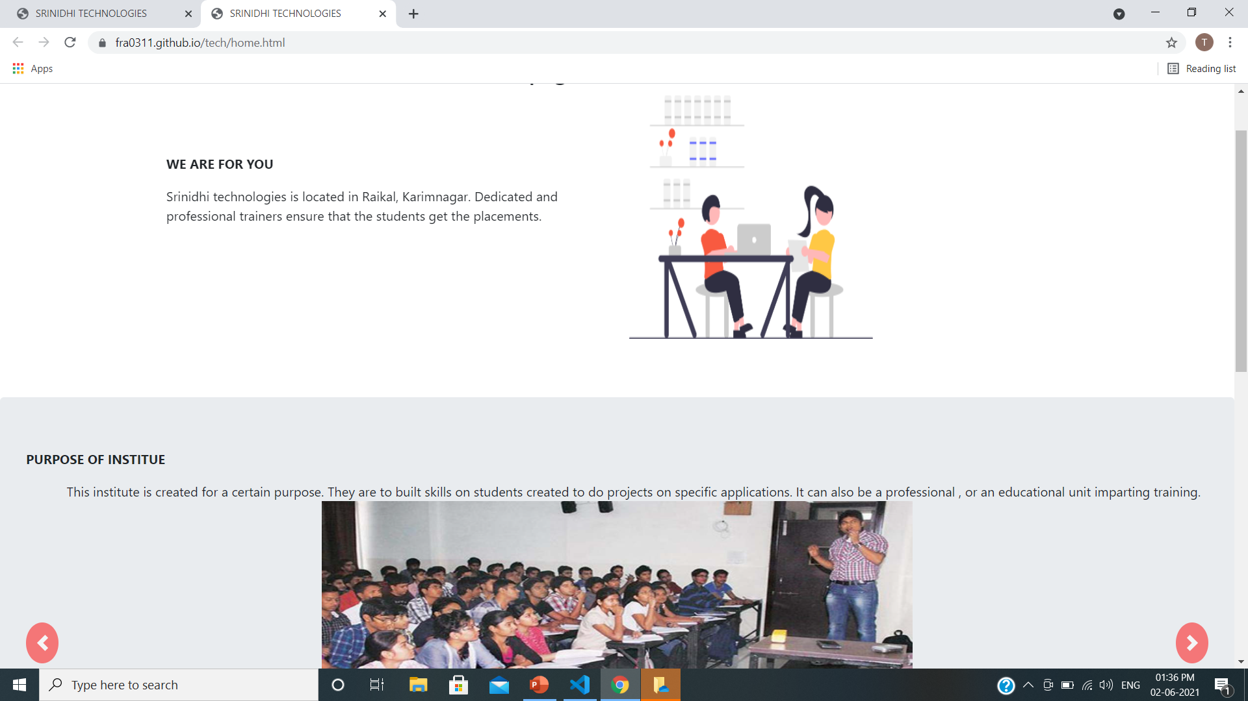
Home page
I used the carousel to the image sliding.
My institution name Srinidhi Technologies . It is
located in raikal , Jagityal .
The purpose of my institution is to provide
quality training and providing placements
to the students

Slide 4
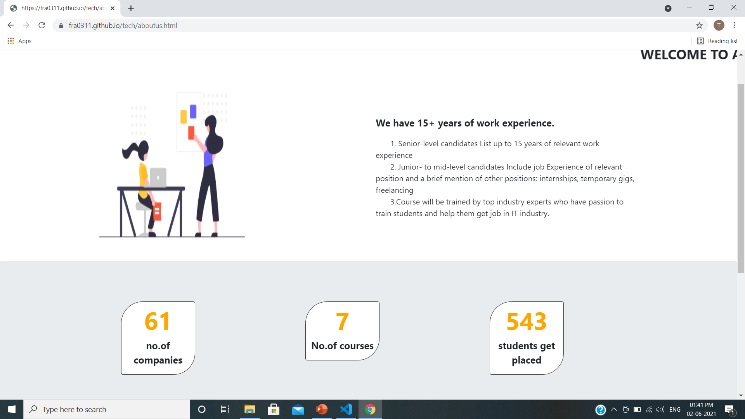
About us
These courses are provide by Top industry experts.
In my institution we had 15+ experienced trainers.
I used the counter function.

Slide 5
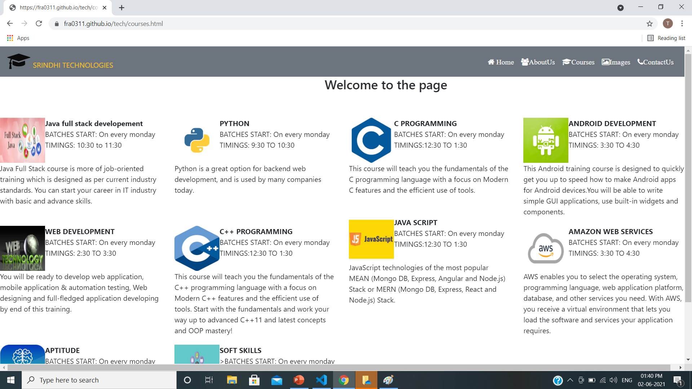

courses
In this I am used grid part.
We are providing ten courses to the students
They are c, c++, python e.t.c.

Slide 6
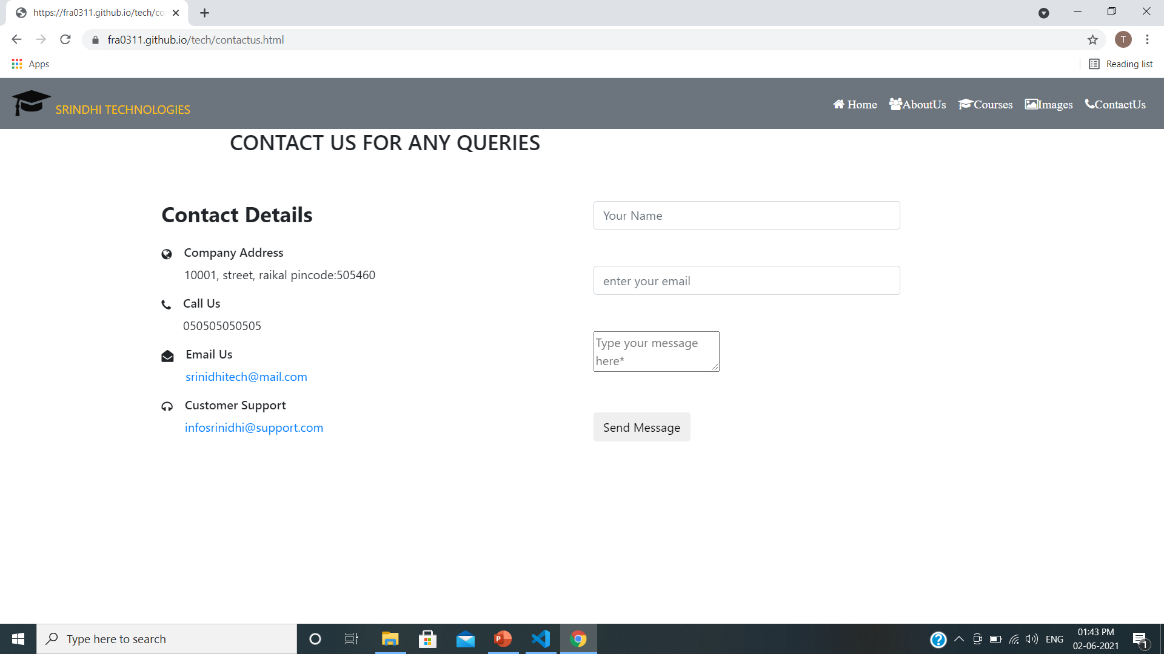
Contact us
I am used grid part and Suitable icons.
For any quires contact through the details what we have provided in our web site
Web site link:
https://fra0311.github.io/tech/home.html

Slide 7
conclusion
we have been providing new technologies and to built perfect
skill to the students who passionate to work.

Slide 8

THANK YOU

